Slide 1

Tasks that Promote Reasoning
and Problem Solving
K-8 Math Leadership Academy 2019-2020
Notes:
Session 1

Slide 2
Today, don’t forget to TWEET and post your thoughts about the session and your excitement for mathematics!
Twitter: @Connect2TLC #TLCpd #MathLeader
Facebook: facebook.com/tlcpage
Notes:
S

Slide 3
Goals to Focus the Learning
Goals to Focus the Learning
Understand the important role of tasks that promote reasoning and problem solving in mathematics instruction
Discuss and engage in characteristics that determine different cognitive levels for tasks and their purpose in an instructional sequence
Learn how to alter a task to elevate the level of demand

Slide 4
It’s OK...
Not to know
To ask questions
To make mistakes
To take risks
To struggle, work and think hard
Have fun!

Slide 5
Reflection
What do you consider when implementing tasks?
How do you know what task to implement?
What are successes and challenges of implementation?

Slide 6
Compare Tasks
Candy Jar
Missing Values
Solve both tasks
&
What did you notice about each task?
What did you use to solve?

Slide 7
Task Reflection
Strategies that could be used
Features of the Problem

Slide 8
Task Analysis Sort
Reflect on the Candy Jar and Missing Values tasks
Determine which statements you believe best align with each of those tasks.
On the back of your cards, mark whether it corresponds to Candy Jar or Missing Values

Slide 9
Task Analysis Labels
Using all the the cards that describe characteristics of different types of tasks, sort these to the category (label) you feel is the best fit.

Slide 10
Low Level Demand: Memorization
If you have cards in this category that do not match, move them and discuss where they might go in the remaining categories.
Involve either reproducing previously learned facts, rules, formulas, or definitions or committing facts, rules, formulas or definitions to memory.
Cannot be solved using procedures because a procedure does not exist or because the time frame in which the task is being completed is too short to use a procedure.
Have no connection to the concepts or meaning that underlie the facts, rules, formulas, or definitions being learned or reproduced.
Are not ambiguous. Such tasks involve the exact reproduction of previously seen material, and what is to be reproduced is clearly and directly stated.

Slide 11
Low Level Demand:
Procedures without Connections
If you have cards in this category that do not match, move them and discuss where they might go in the remaining categories.
Are algorithmic. Use of the procedure either is specifically called for or is evident from prior instruction, experience, or placement of the task.
Require limited cognitive demand for successful completion. Little ambiguity exists about what needs to be done and how to do it.
Are focused on producing correct answers instead of on developing mathematical understanding
Require no explanations or explanations that focus solely on describing the procedure that was used.
Have no connection to the concepts or meaning that underlie the procedure being used.

Slide 12
High Level Demand:
Procedures with Connections
If you have cards in this category that do not match, move them and discuss why these might belong in High Level: Doing Mathematics
Suggest explicitly or implicitly pathways to follow that are broad general procedures that have close connections to underlying conceptual ideas as opposed to narrow algorithms that are opaque with respect to underlying concepts.
Focus students’ attention on the use of procedures for the purpose of developing deeper levels of understanding of mathematical concepts and ideas.
Require some degree of cognitive effort. Although general procedures may be followed, they cannot be followed mindlessly. Students need to engage with conceptual ideas that underlie the procedures to complete the task successfully and that develop understanding.
Usually are represented in multiple ways, such as visual diagrams, manipulatives, symbols, and problem situations Making connections among multiple representations helps develop meaning.

Slide 13
Require students to explore and understand the nature of mathematical concepts, processes, or relationships.
Require students to access relevant knowledge and experiences and make appropriate use of them in working through the task.
High Level Demand: Doing Mathematics
Require considerable cognitive effort and may involve some level of anxiety for the student because of the unpredictable nature of the solution process required.
Demand self-monitoring or self-regulation of one’s own cognitive processes.
Require students to analyze the task and actively examine task constraints that may limit the possible solution strategies and solutions.
Require complex and non-algorithmic thinking - a predictable, well-rehearsed approach or pathway is not explicitly suggested by the task, task instructions, or a worked-out example.

Slide 14
Reflect: Candy Jar and Missing Values
Looking at the Task Analysis categories and characteristics, check your thinking on the back of the statement cards.
Discuss: What category would you place each task?

Slide 15
Task Cards
Examine and Solve the tasks
Reflect: How do you engage with the mathematics of each task?

Slide 16
Task
Alignment
Determine which category each task best aligns with
Use the task analysis guide to support your thinking

Slide 17
Task Card and Analysis Guide Alignment
Check your thinking and reasoning
Discuss: How are you thinking differently about tasks?

Slide 18
Elevating a Tasks Cognitive Level
Choose two Low Level tasks and determine how you could change the task to create a High Level task
Be sure to use different strategies and instructional decisions when altering each task
Record your ideas on the Rethinking Tasks graphic organizer

Slide 19
Quote Carousel
Reflect on today’s learning

Slide 20
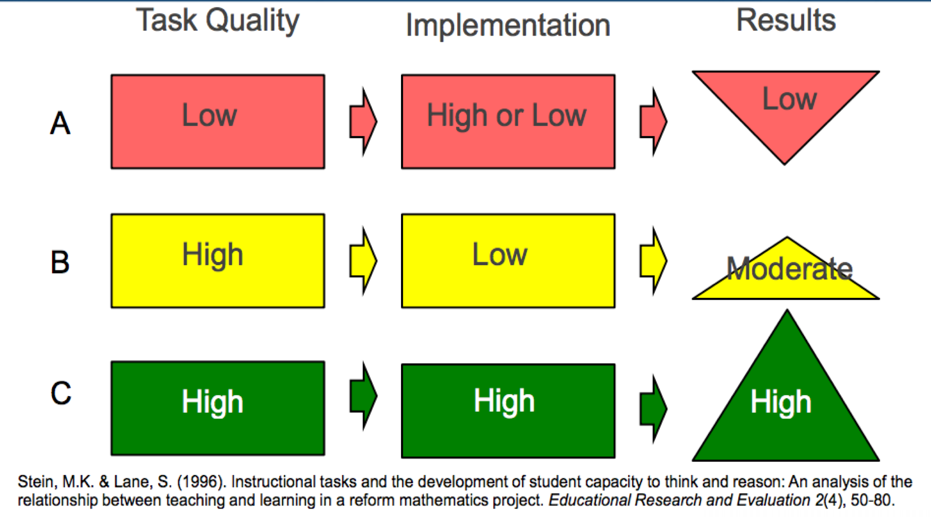
What does this mean for instruction?

Slide 21
Tasks that Promote Reasoning and Problem Solving
Former NCTM President Diane Briars
To what extent do kids have an opportunity to every single day engage in rich mathematics?

Slide 22
EXIT TICKET

